Slide 1

D. Y. PATIL COLLEGE OF ENGINEERING, AKURDI, PUNE
Department of Electronics and Telecommunication
Project Title :-
“ Intrusion Detection System Using Machine Learning“
Presented by :-
Rahul Kumar Rohit Bhandare Tejas Bhagat
B150083069 B150083021 B150083019
Guided by :
Prof :- Mrs Sayali N. Mane
1

Slide 2
Content
Abstraction
Significance Of the Project
Literature Survey\
Objectives
Block diagram
Explanation
Algorithms
Simulation and Results
Graphs
Applications
Future Scope
Conclusion
References

Slide 3


Slide 4
Abstraction :-
1. Given the increasing complexity of today’s network environments, more and more hosts
are becoming vulnerable to attacks.
2. Intrusion is the breach of security policy with malicious intent.
3. The detection of malicious activities is of two types, the misuse or signature-based detection in which the
IDS collects information, analyzes it and then compares it to the attack signatures stored
in a large database
4. Here we discuss some Machine Learning based approaches for intrusion detection and compare their
merits and demerits.
5.We then discuss the architecture of an advanced Intrusion Detection
System, Snort and suggest some enhancements to the same.

Slide 5
Significance Of Project :-
The IDS acts as a network level defense to secure a computer network. The intrusion or threat comes in a form of anomaly in a network.
The IDS generates logs and alert the network administrator after the occurrence of malicious activity in a network .
Unlike a firewall, which sits at the perimeter and acts as a gatekeeper to monitor network traffic and determine if it should be allowed into the network or endpoint at all, an IDS focuses on the traffic that is on the internal network to identify any suspicious or malicious activity.

Slide 6
Literature survey
Sr. No. | Title Of The Paper | Author | Published Year | Abstraction | Conclusion
1) | A Review of Intrusion Detection System using Machine Learning Approach | SH Kok, Azween Abdullah, NZ Jhanjhi, Mahadevan | Nov 2019 | This study aims to analyse recent researches in IDS using Machine Learning (ML) approach; with specific interest in dataset, ML algorithms and metric. Dataset selection is very important to ensure model build is suitable for IDS use. In addition, dataset structure can affect the effectiveness of ML algorithms. Thus, ML algorithm selection is dependent on the structure of the selected dataset. After that, metric will provide a quantitative evaluation of ML algorithms towards specific dataset. | This study found that soft computing techniques are getting considerable attention, as many have applied it here.

Slide 7
Sr. No. | Title Of The Paper | Author | Published Year | Abstraction | Conclusion
2) | Intrusion Detection System using Machine Learning Techniques: A Review | Usman Shuaibu Musa , Megha Chhabra | 2020 | The proposed paper presents an overview of various works being done on building an efficient IDS using single, hybrid and ensemble machine learning (ML) classifiers, evaluated using seven different datasets. The results obtained by various works were discussed and compared which gives a clear path and guide for future work. | This paper presented various research papers related to using machine learning classifiers in intrusion detection systems published from 2015 to 2020. Among the various models applied in the studied research papers, ensemble and hybrid classifiers have been able to surpass their single classifier counterpart and hence have the better predictive accuracy and detection rate

Slide 8
Objectives
State the function of an Intrusion Detection System.
2. Evaluate exterior and interior classifier sensor placement(different algorithms) effectiveness.
3. Consider trade-offs that influence exterior IDS design effectiveness.
4. Identify factors that influence interior sensor effectiveness.

Slide 9
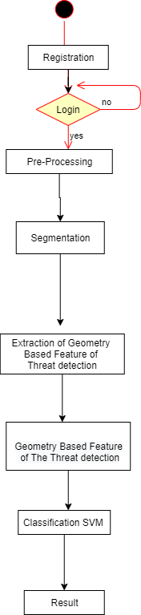
Flow Chart:-

Slide 10
Explanation :-
1.Registration
2. Log In
3. Pre-Processing
4. Segmentation
5. Extraction of Geometry Based Threat Detection
6.Classification Of SVM
7. Result

Slide 11
Algorithms Used :-
1.XG_Boost
2. SVM
3. Naïvey Bayes
4. Decision Tree
5. Random Forest

Slide 12
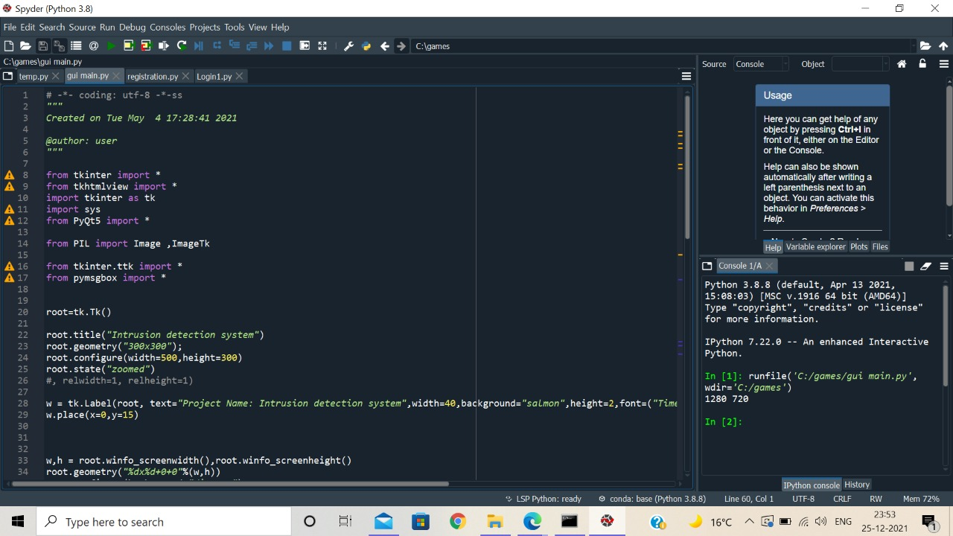
Simulation And Results

Slide 13
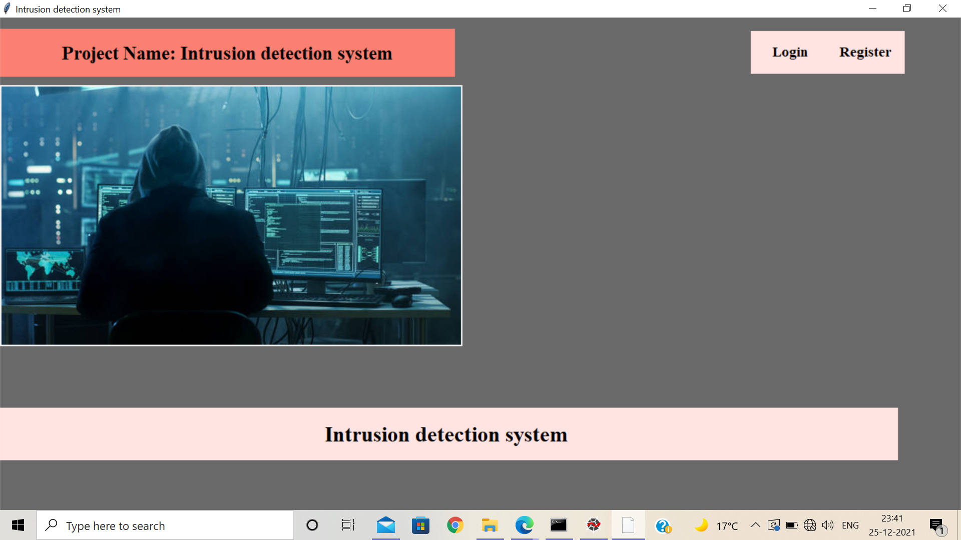
Simulation And Results

Slide 14
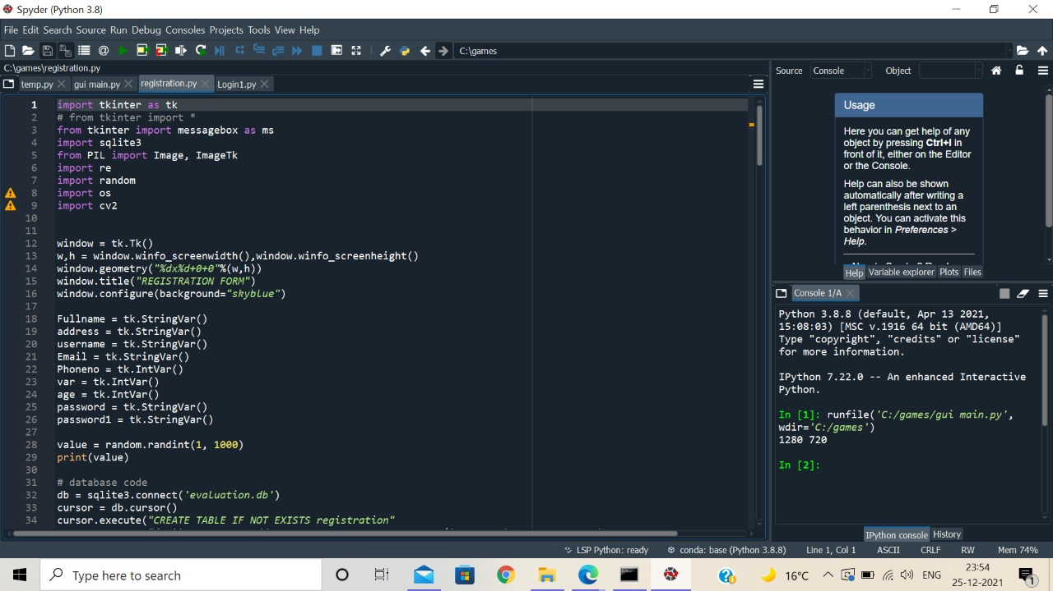
Simulation And Results

Slide 15

Simulation And Results

Slide 16
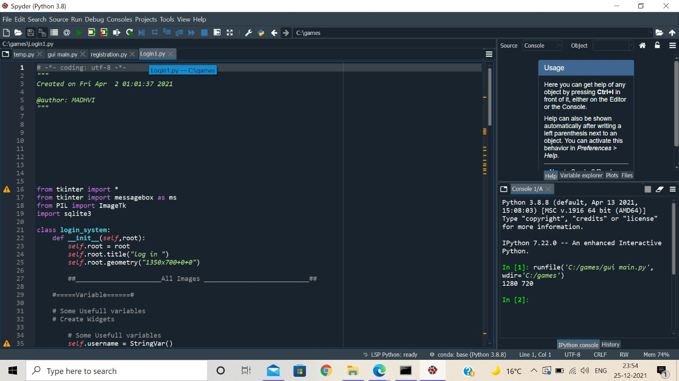
Simulation And Results

Slide 17

Simulation And Results

Slide 18
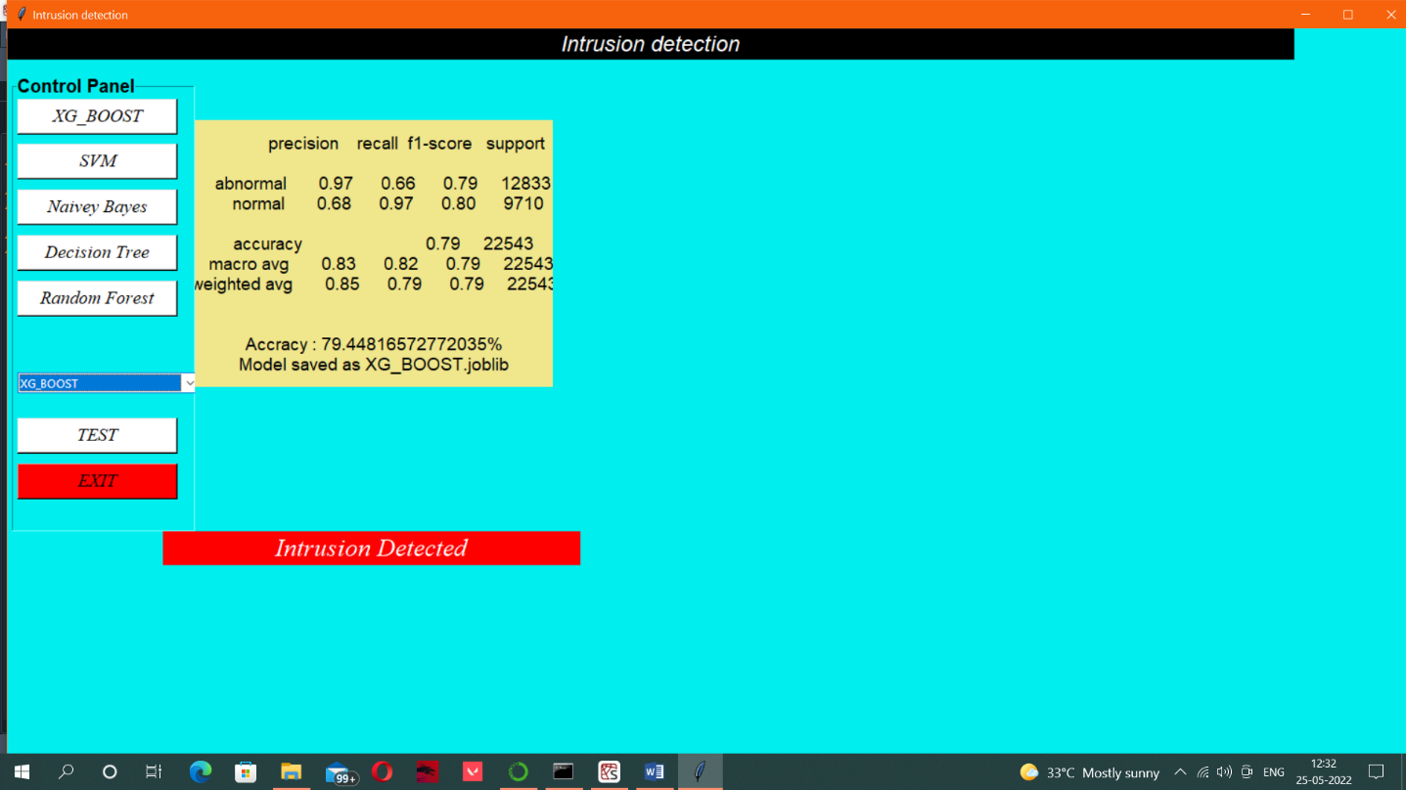
Simulation And Results

Slide 19
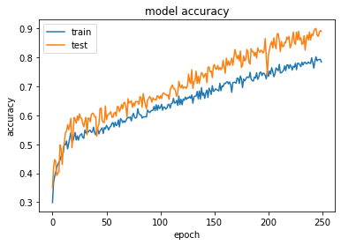
Graphs:-

Slide 20
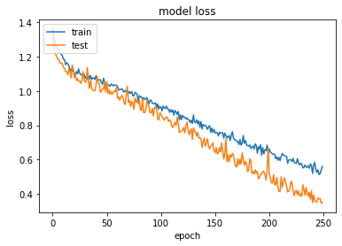
Graphs:-

Slide 21
Applications:-
Selective logging.
Privacy protection.
Reputation-managed protection.
Multiple threat protection.

Slide 22
Future Scope:-
Automated Monitoring Systems
Penetration Testing

Slide 23
Conclusion:-
1. The industrial Intrusion network based network is rapidly growing in the coming future.
2. The detection of software piracy and malware Intrusion are the main challenges in the field of cybersecurity using Intrusion network-based big data.
3. We collected 100 programmers’ source codes files from KC99 to investigate the proposed approach.
4. The source code is preprocessed to clean from noise and to capture further the high- quality features which include useful tokens.

Slide 24
References:-
D.P. Gaikwad and Ravindra C. Thool. (2015). Intrusion detection system using bagging with partial decision tree base classifier. Procedia Computer Science 49 (pp. 92-98). Elsevier.)
W. –C. Lin, Shih-Wen K. Chih-Fong T. (2015). Intrusion detection system based on combining cluster centers and nearest neighbors. Knowledge-Based Systems 78 (pp. 13-21). Elsevier
A.S.A. Aziz. (2016). Comparison of classification techniques applied for network intrusion detection and classification. Journal of Applied Logic 24. Elsevier, 109-118.
Nabila Farnaaz and M.A Jabbar. (2016). Random Forest Modeling for Network Intrusion Detection System. International Multi-conference on information processing (IMCIP) 12 (pp. 213-217). Elsevier
Kayvan A. Saadiah Y. Amirali R. and Hazyanti S. (2016). Anomaly Detection Based on Profile Signature in Network using Machine Learning Techniques. IEEE TENSYMP. (pp. 71-76). IEEE

